Slide 1
Введение в нейросети
Part 1
tg: @naconov, @zamyrailov
GitHub: NasonovIvan, maykitbo

Slide 2
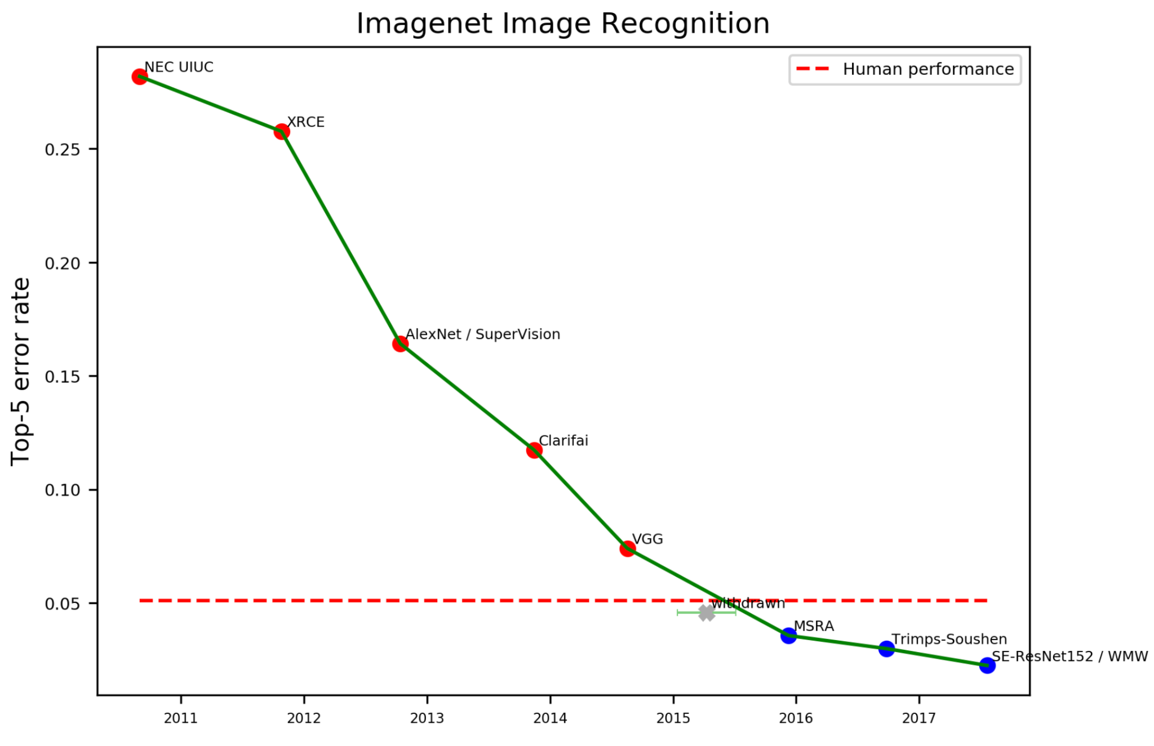
Image Recognition
https://www.eff.org/ai/metrics

Slide 3
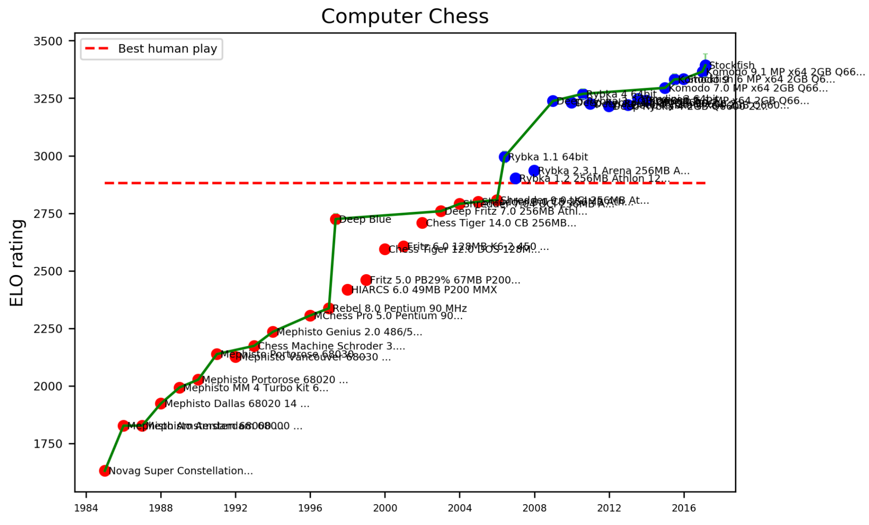
Computer Chess Rating
https://www.eff.org/ai/metrics

Slide 4
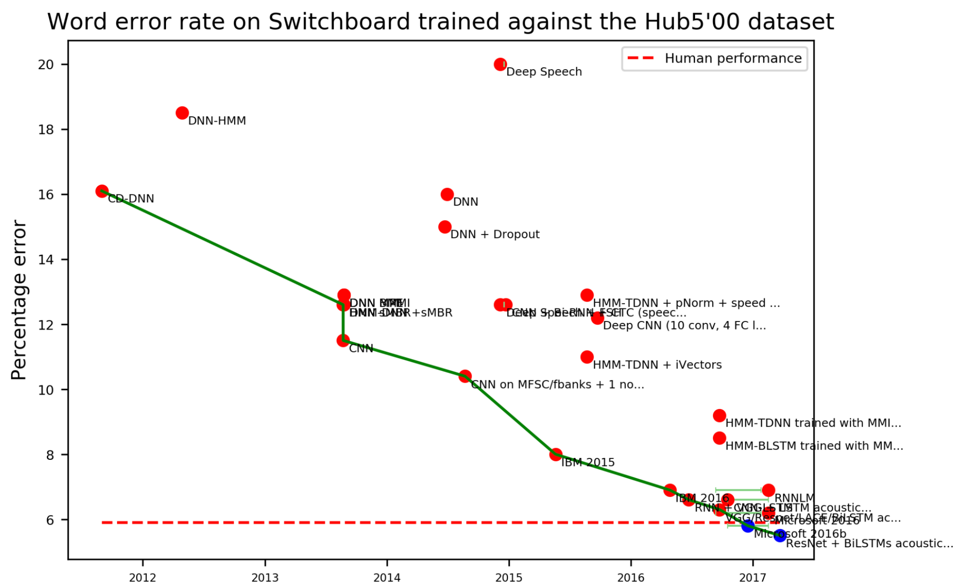
Speech Recognition
https://www.eff.org/ai/metrics

Slide 5
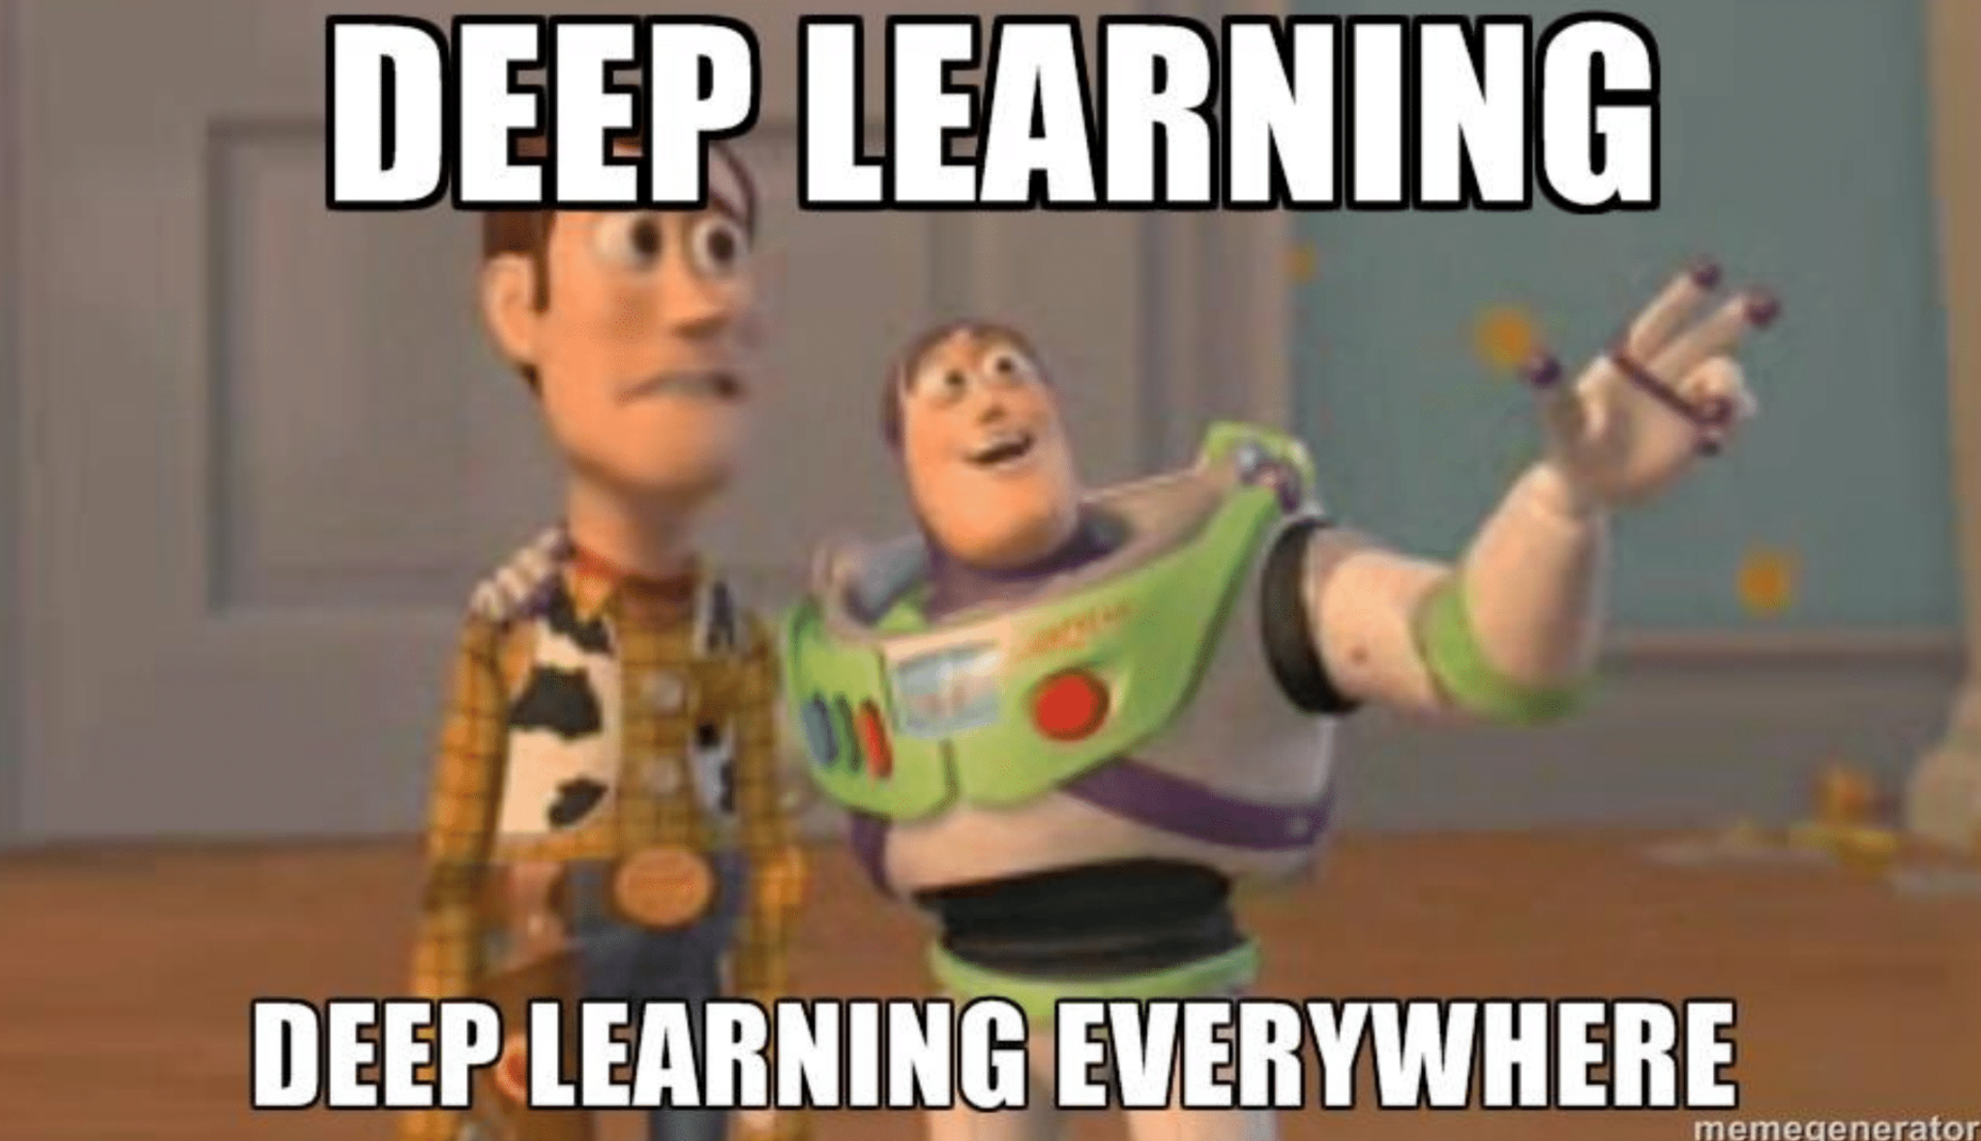

Slide 6
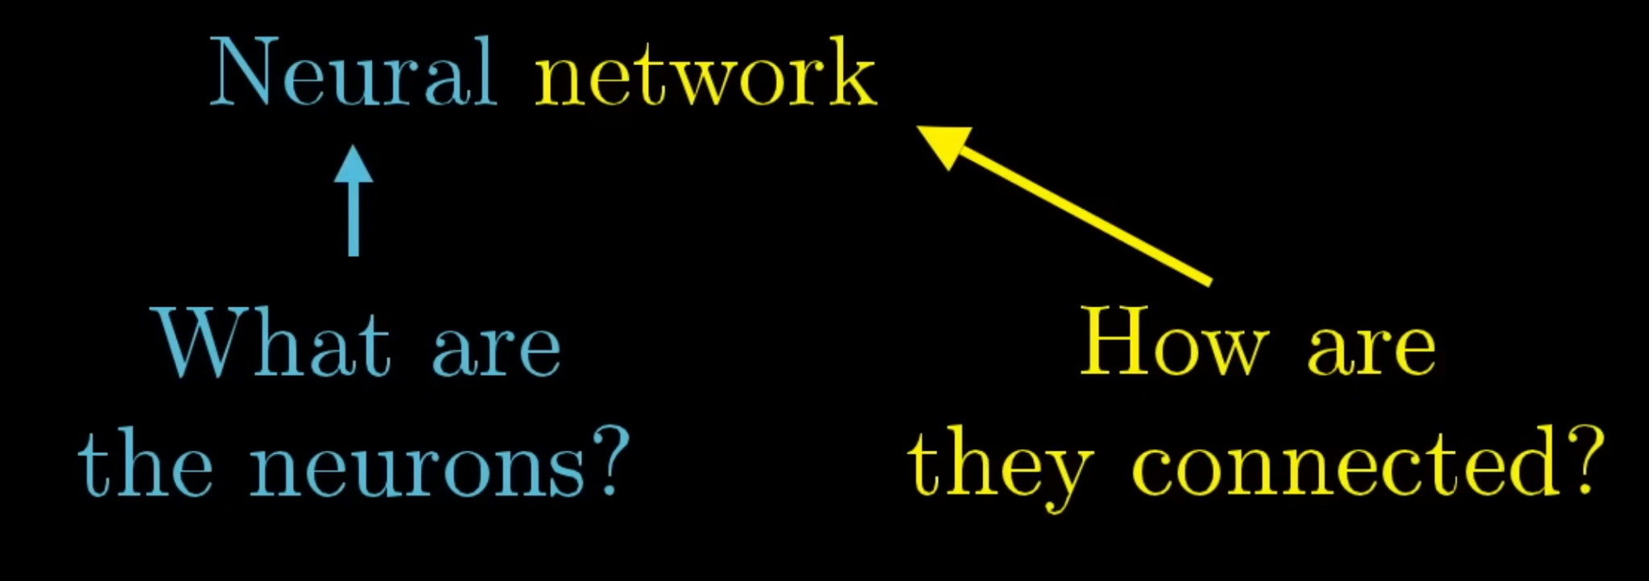
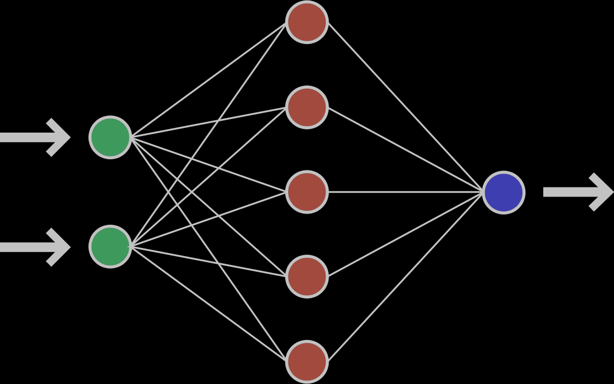
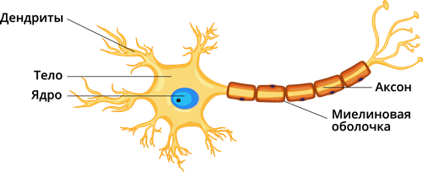
3Blue1Brown

Slide 7
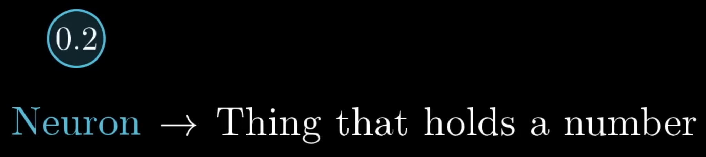
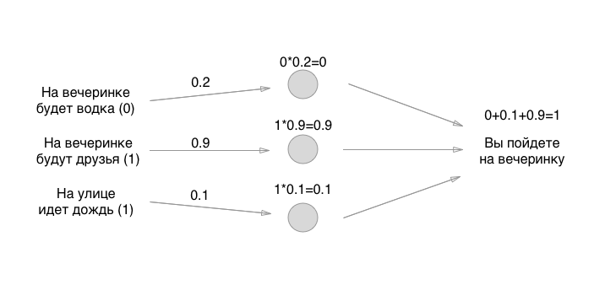
3Blue1Brown Habr

Slide 8
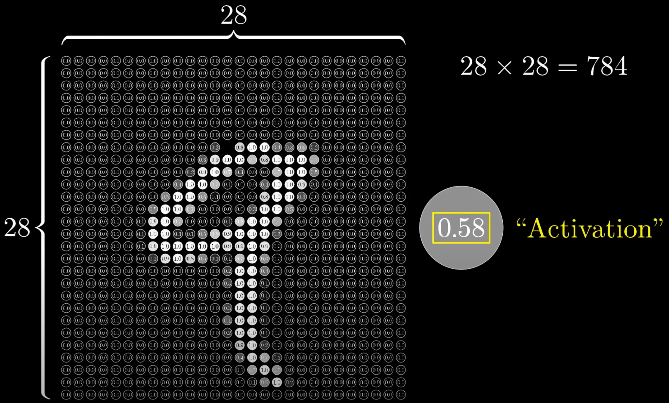
3Blue1Brown

Slide 9
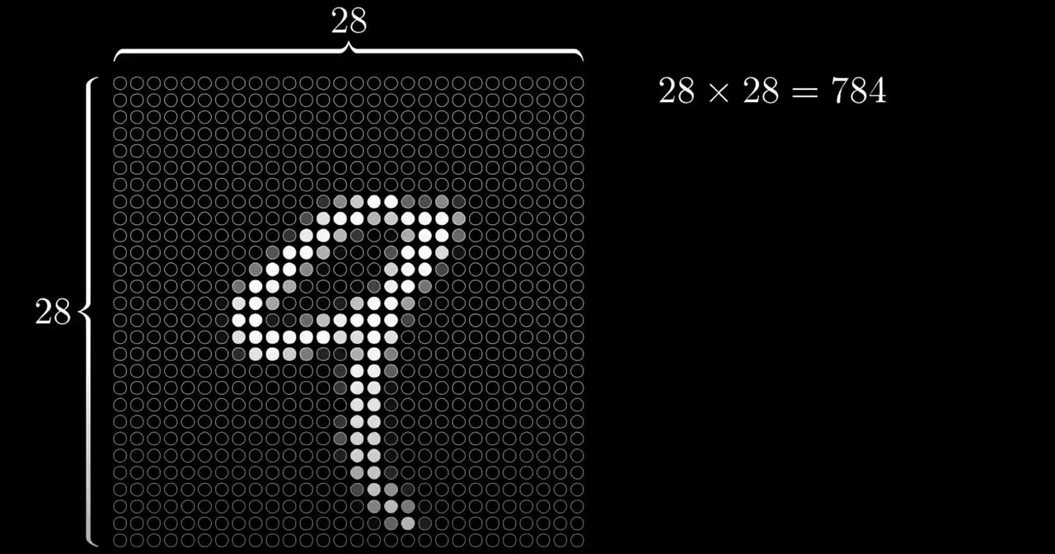
3Blue1Brown

Slide 10
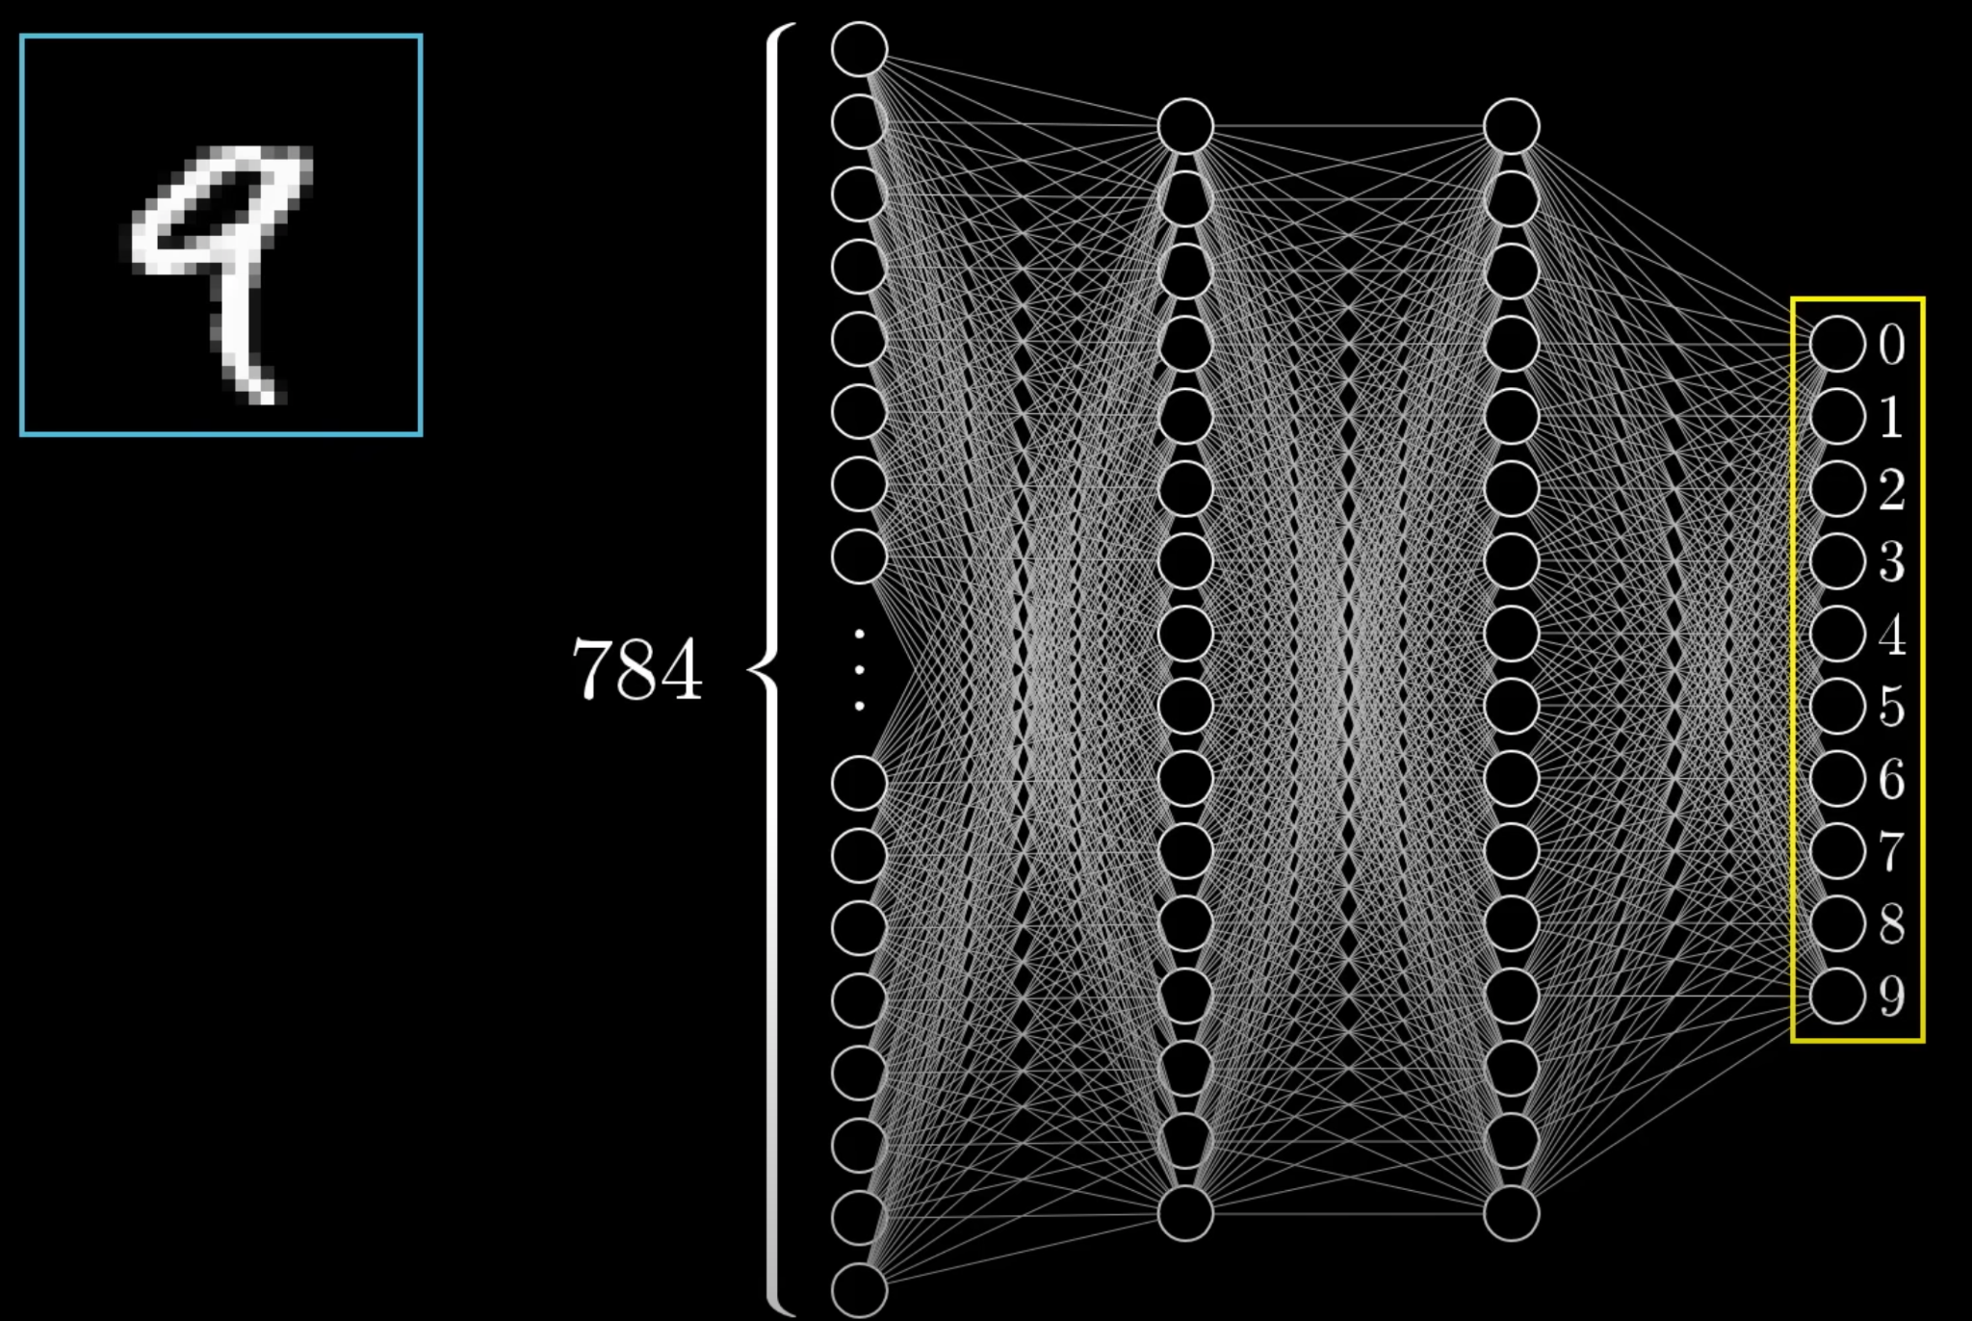
3Blue1Brown

Slide 11
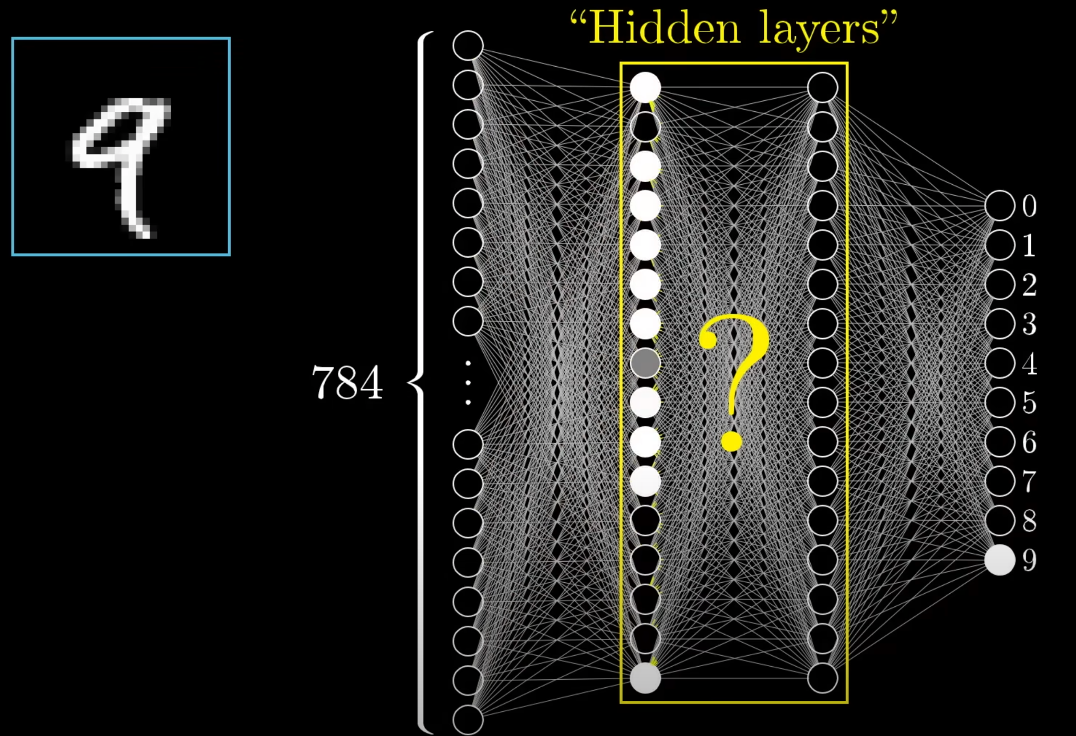
3Blue1Brown

Slide 12
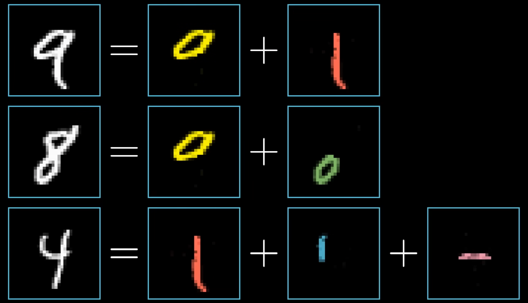
3Blue1Brown

Slide 13
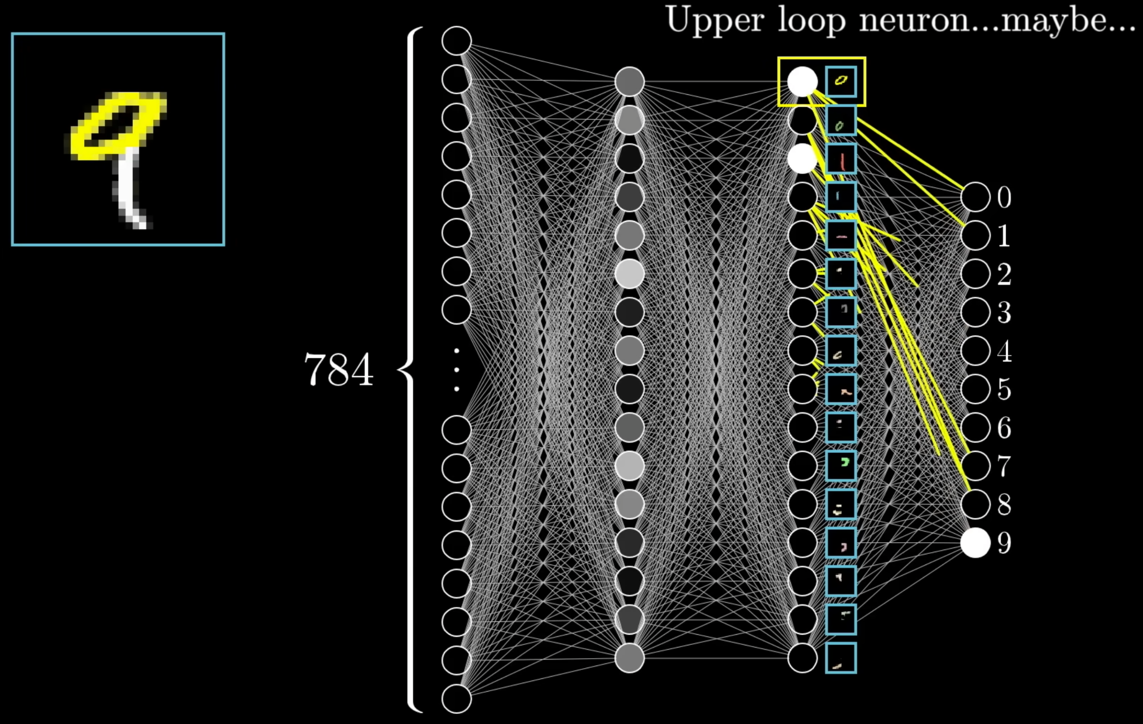
3Blue1Brown

Slide 14
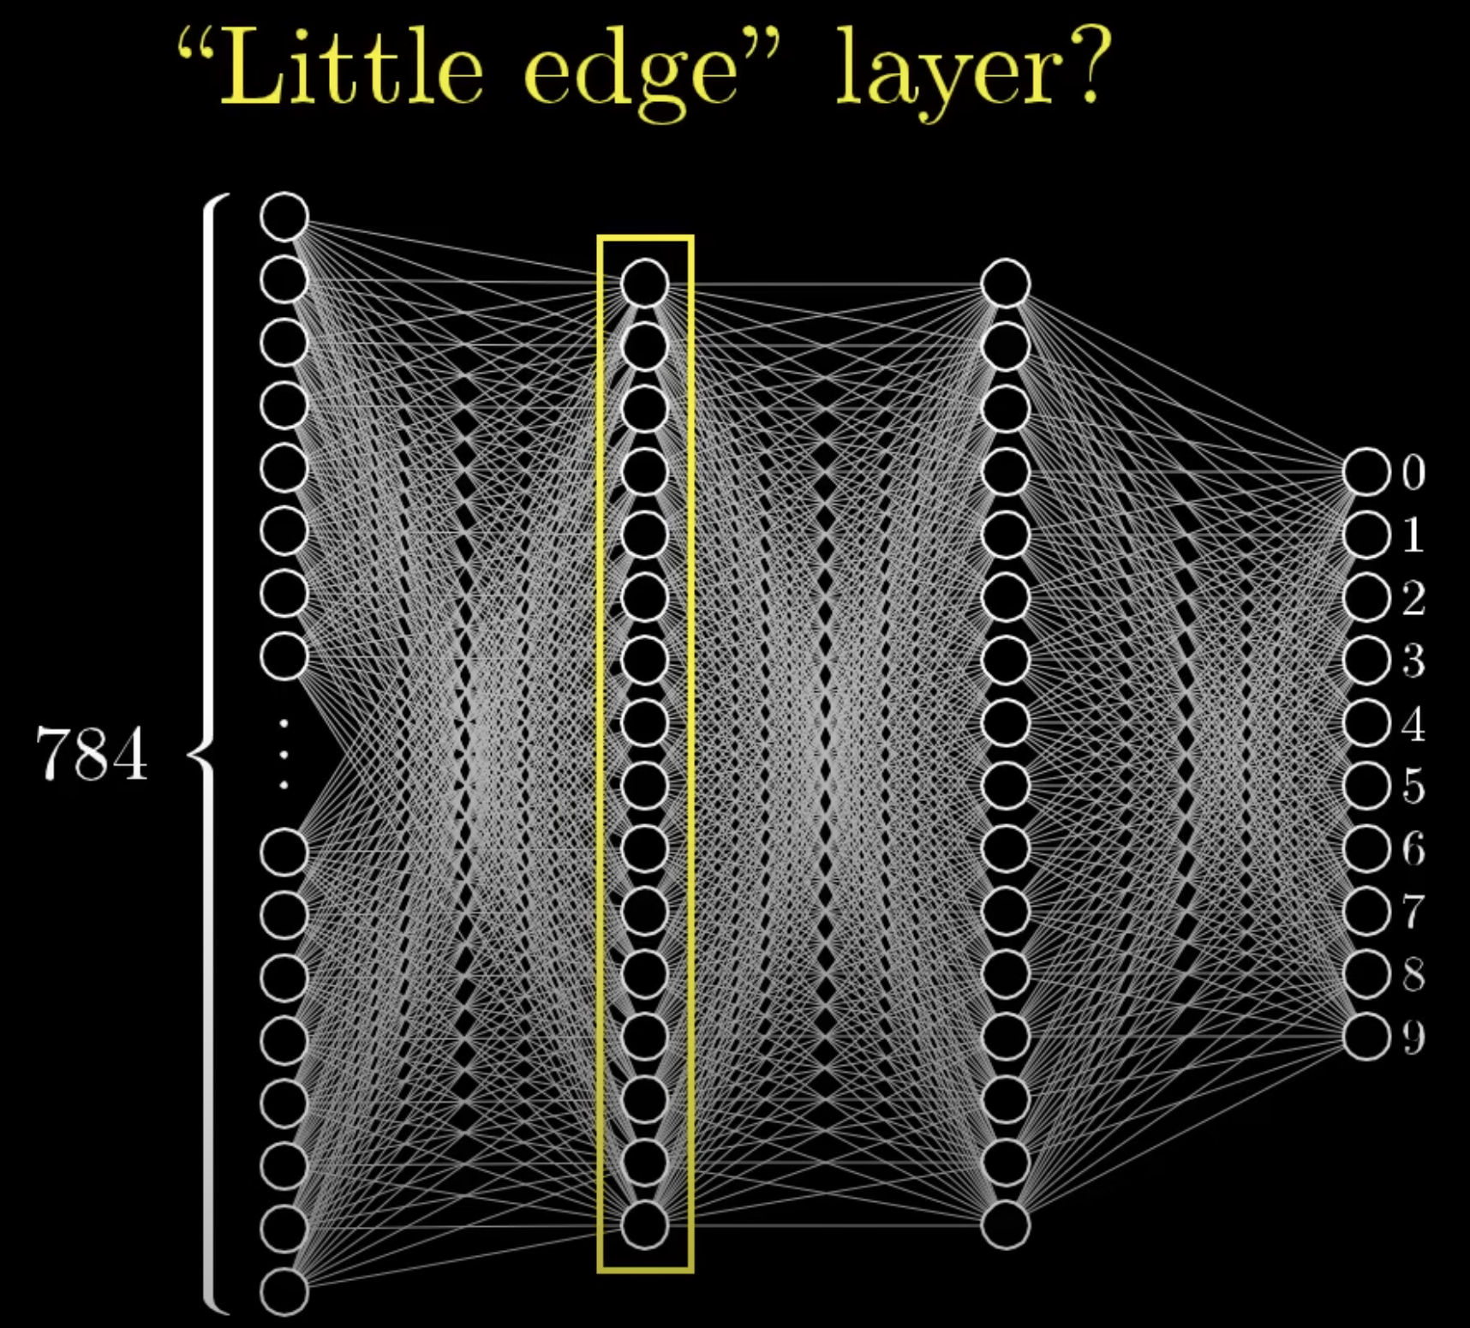
3Blue1Brown

Slide 15
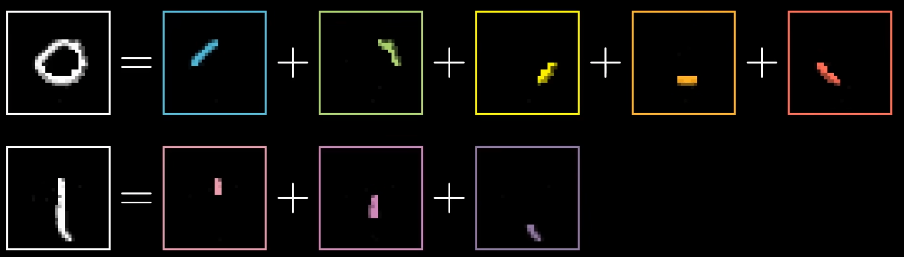
3Blue1Brown

Slide 16
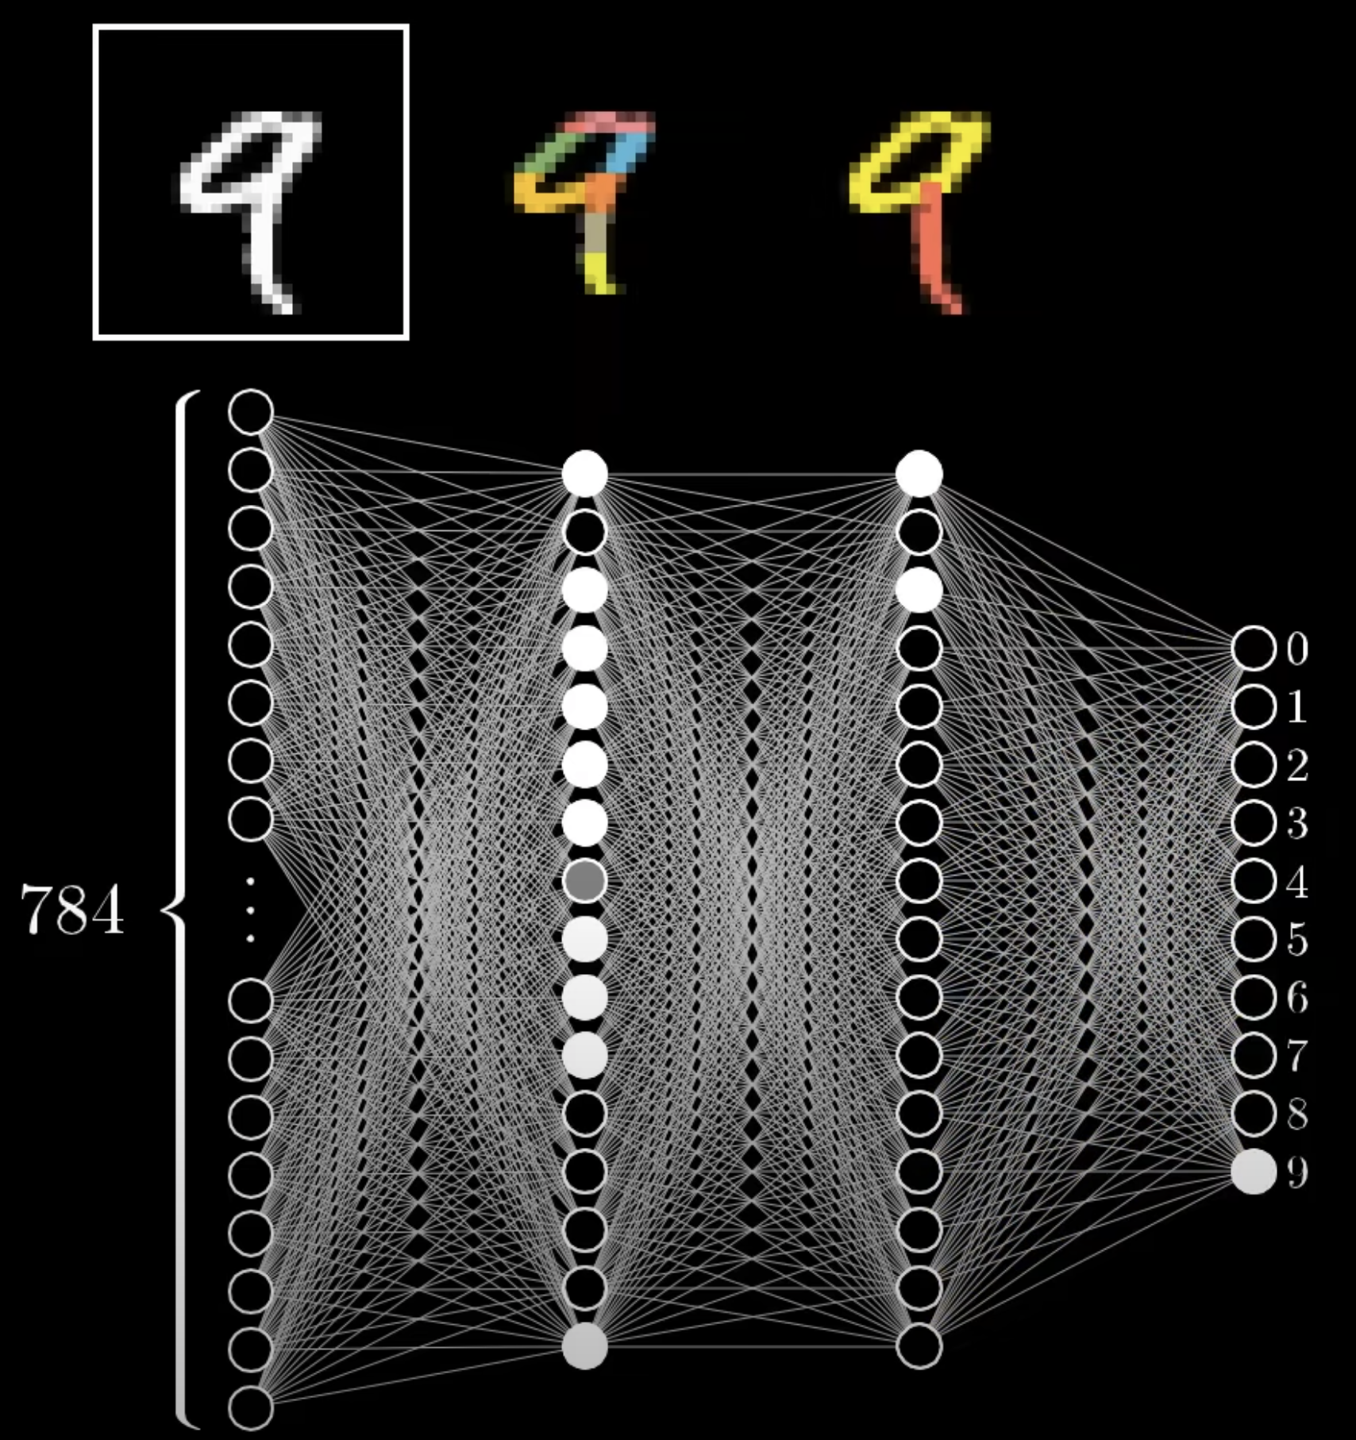
3Blue1Brown

Slide 17
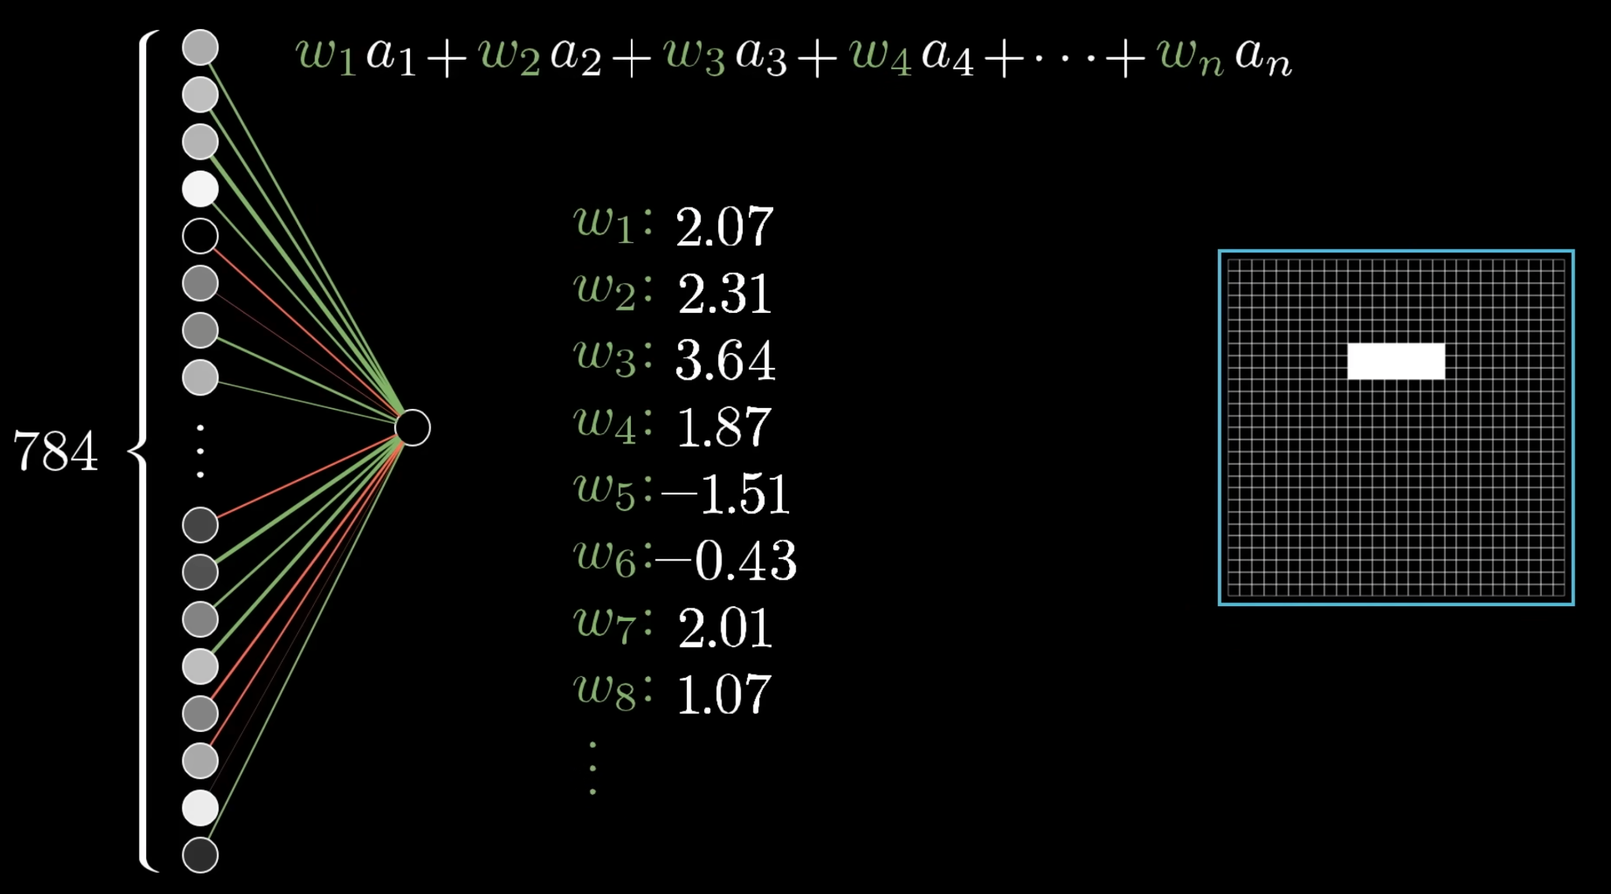
3Blue1Brown

Slide 18
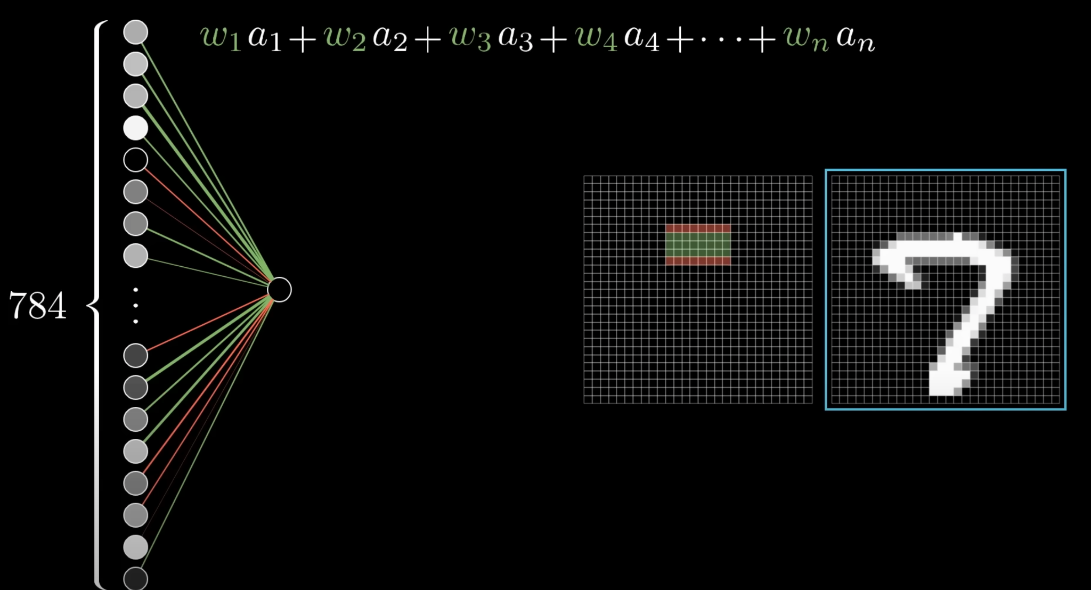
3Blue1Brown

Slide 19
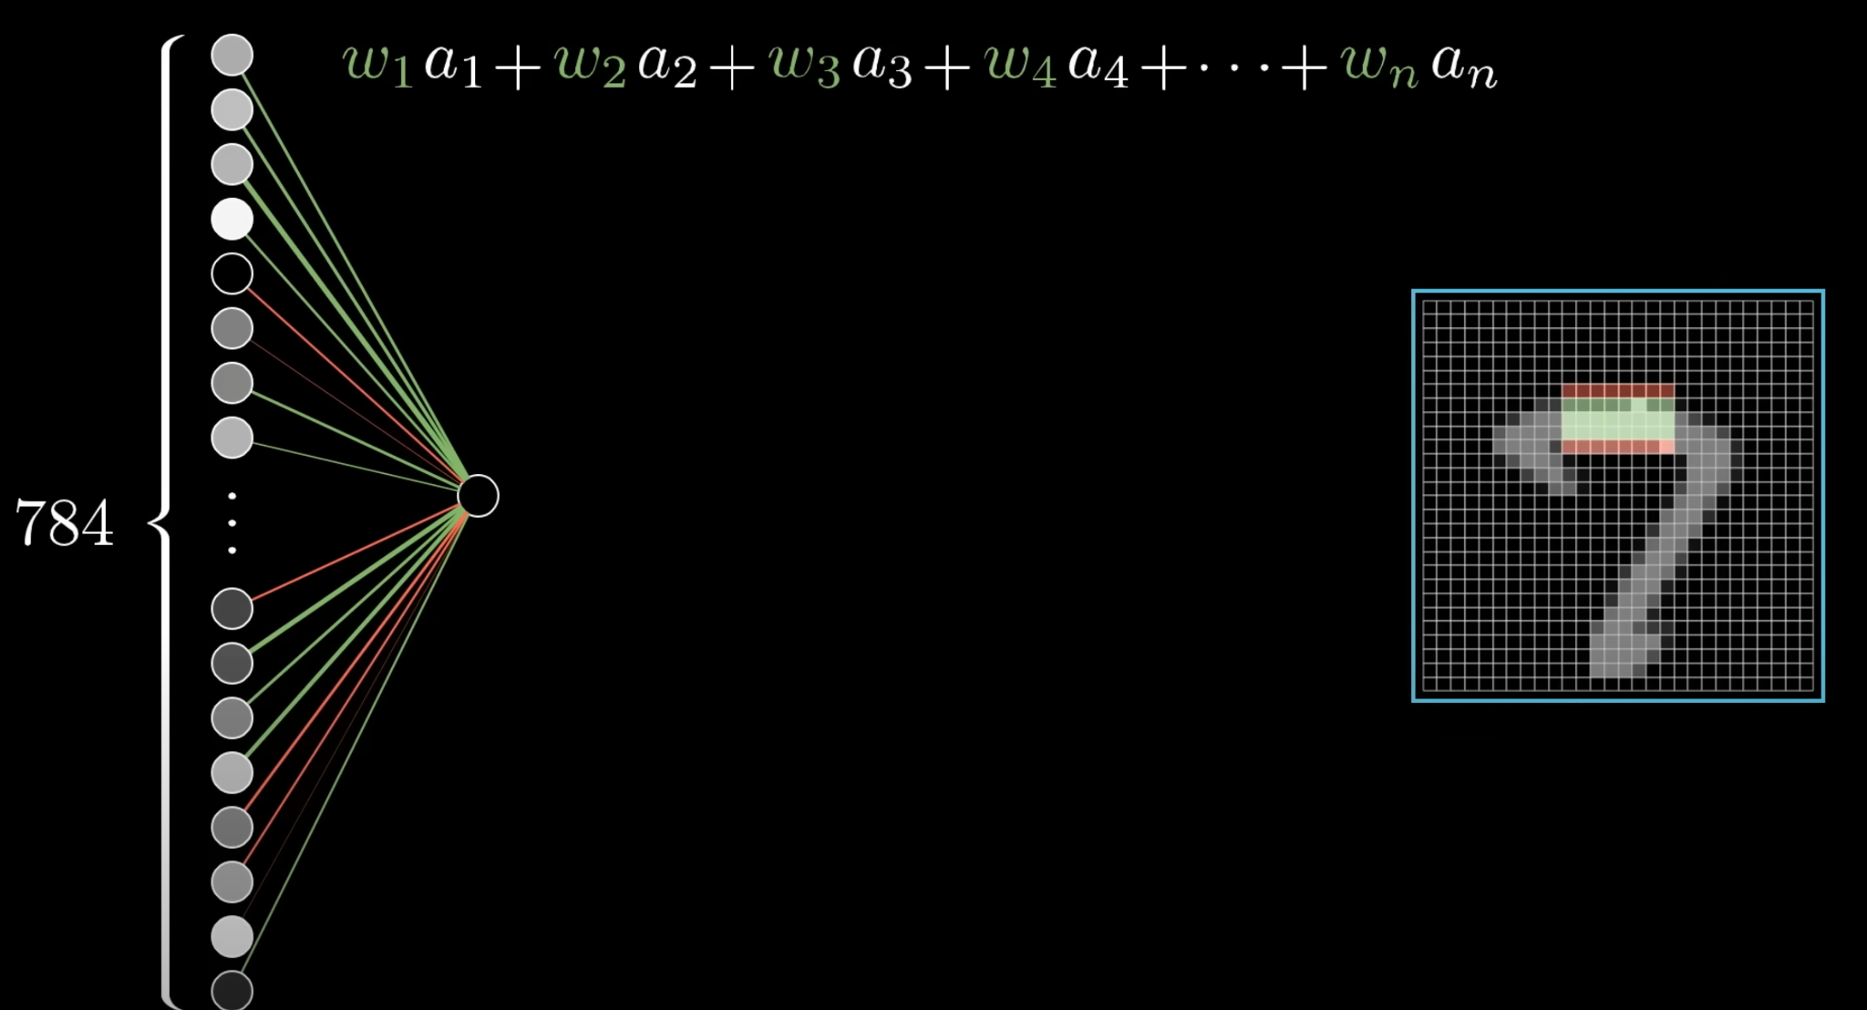
3Blue1Brown

Slide 20
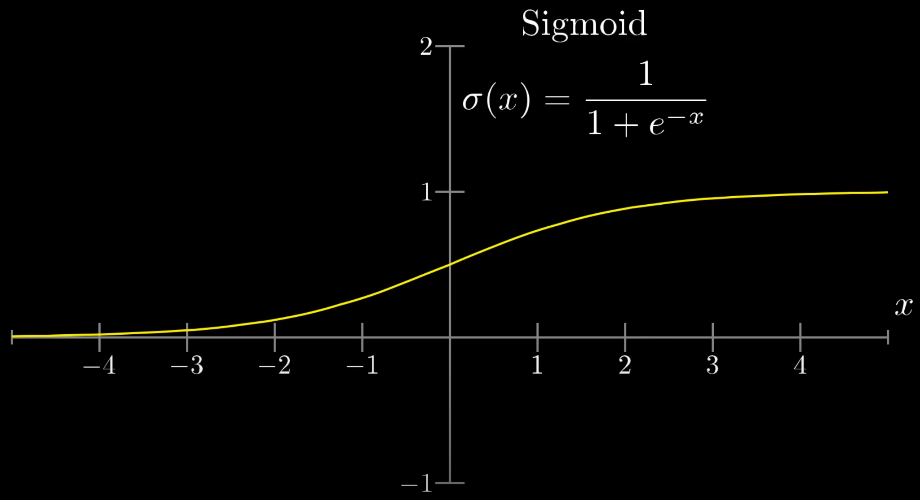
3Blue1Brown

Slide 21
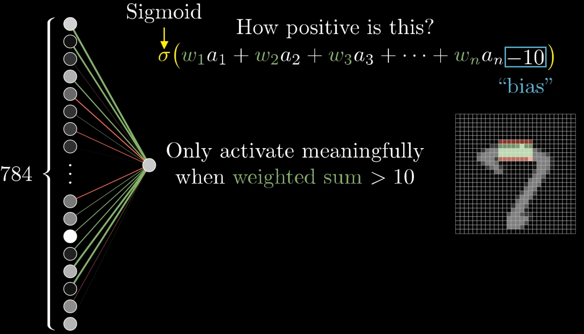
3Blue1Brown

Slide 22
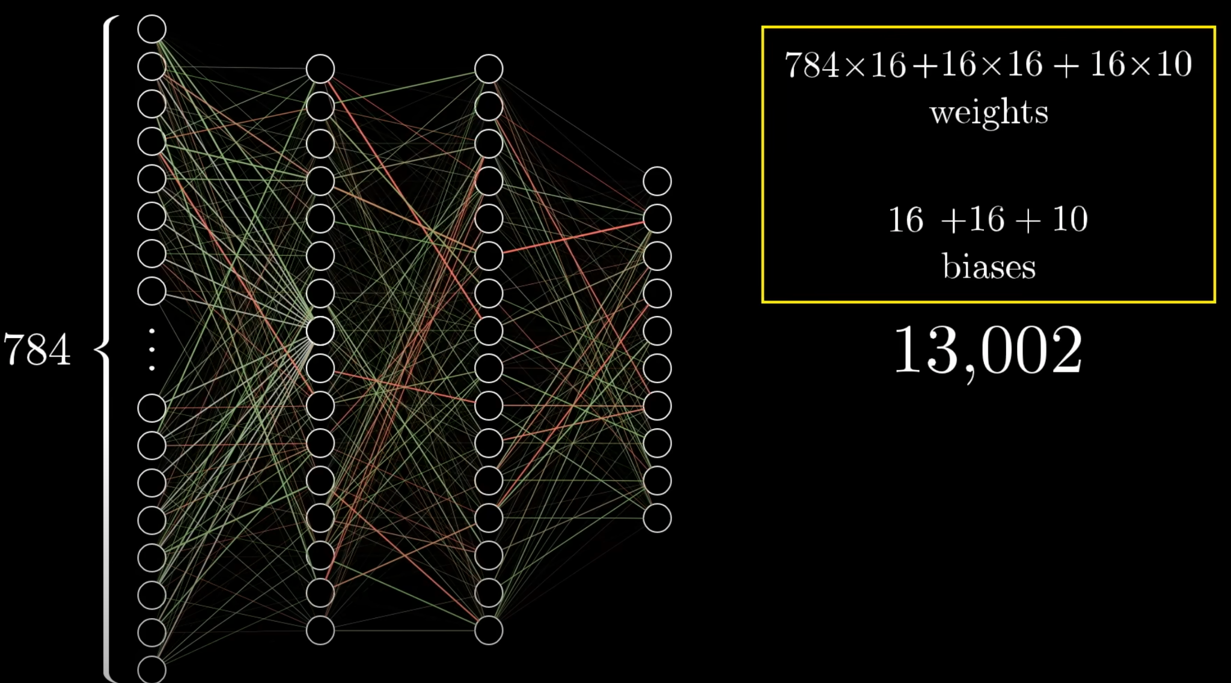
3Blue1Brown

Slide 23
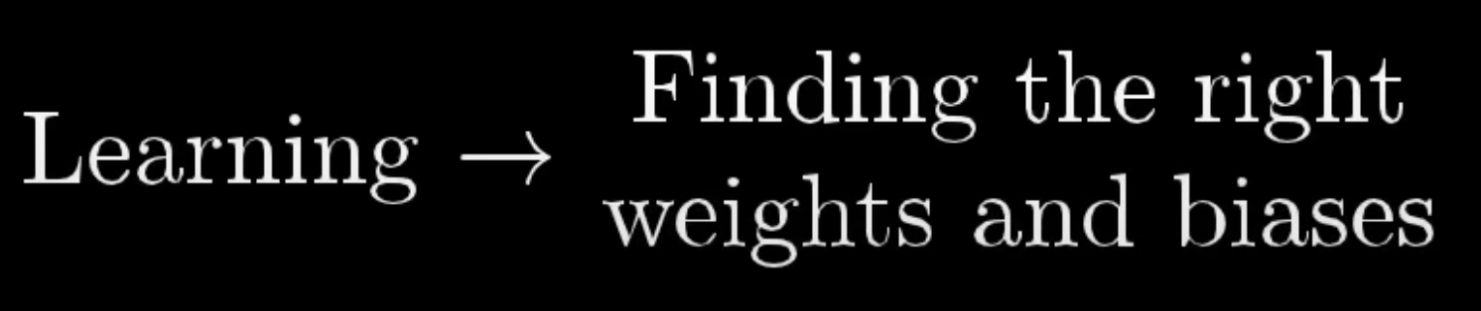
3Blue1Brown

Slide 24

3Blue1Brown

Slide 25
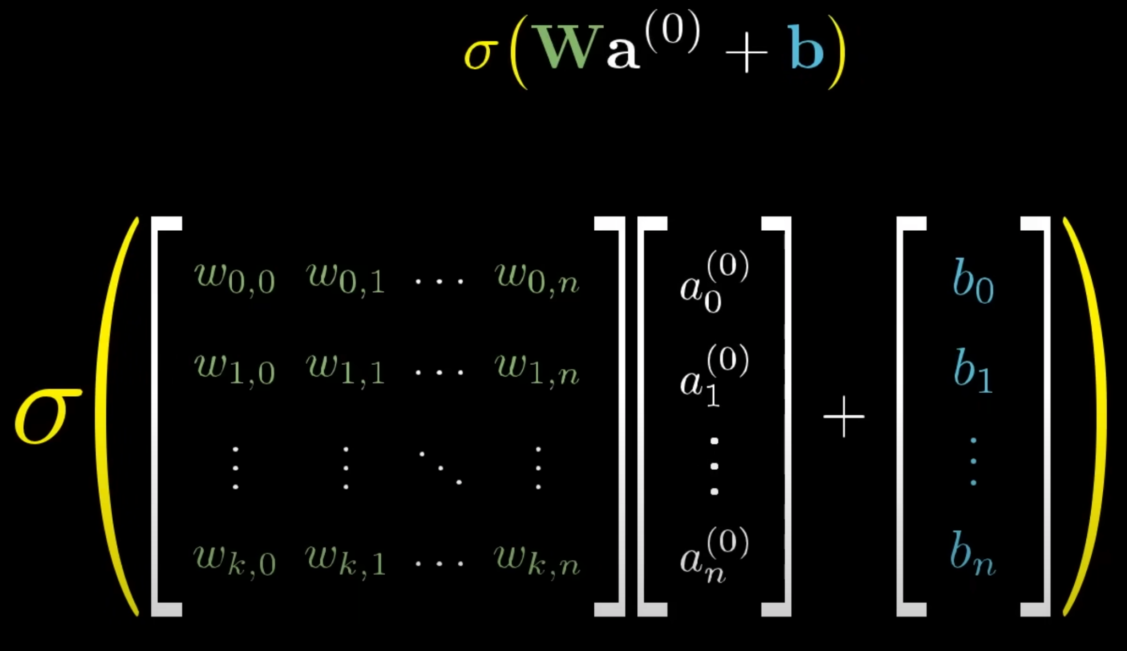
3Blue1Brown

Slide 26
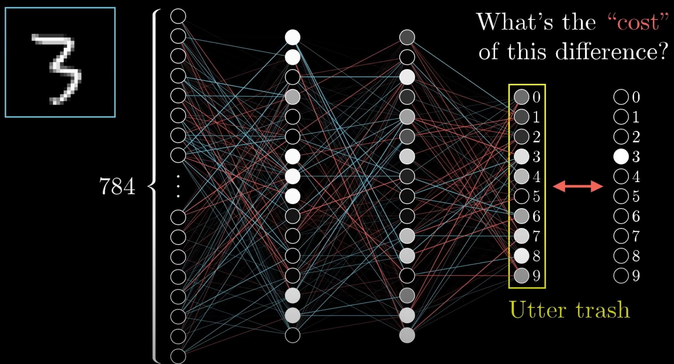
3Blue1Brown

Slide 27
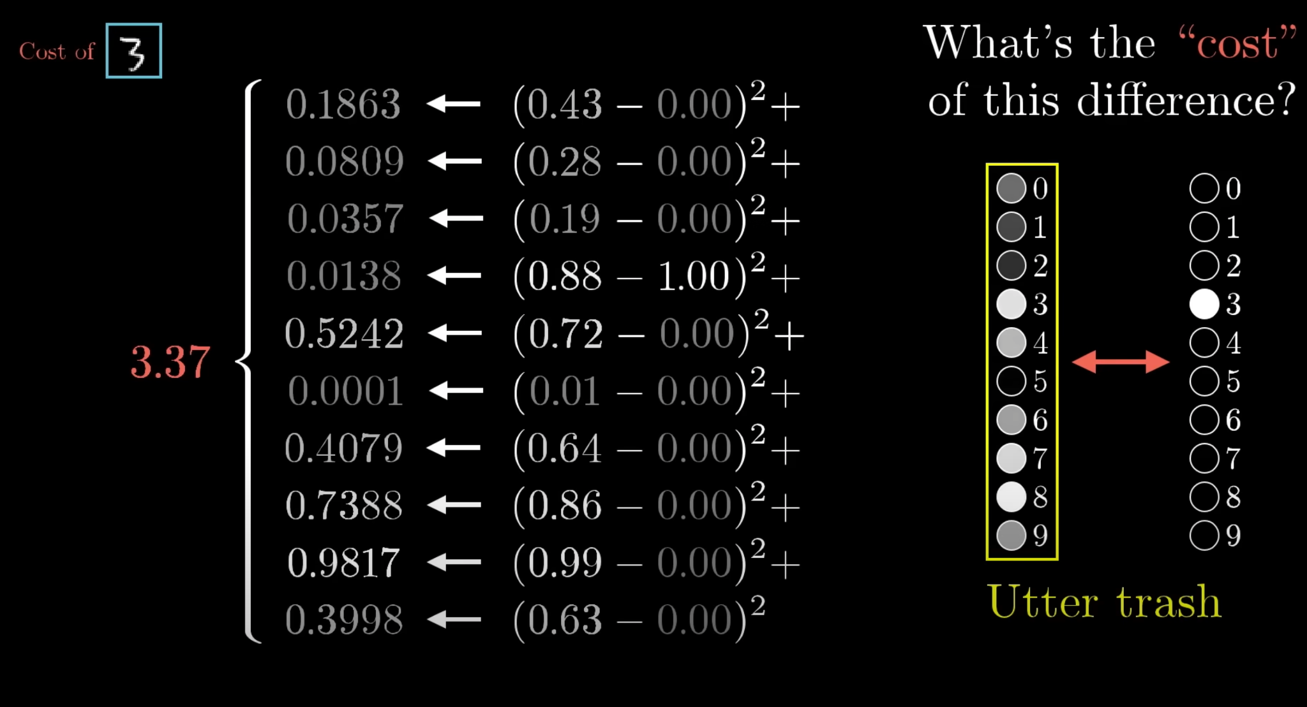
3Blue1Brown

Slide 28
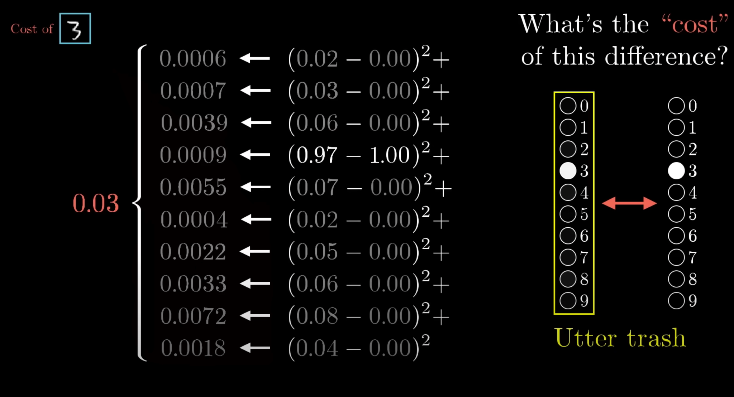
3Blue1Brown

Slide 29
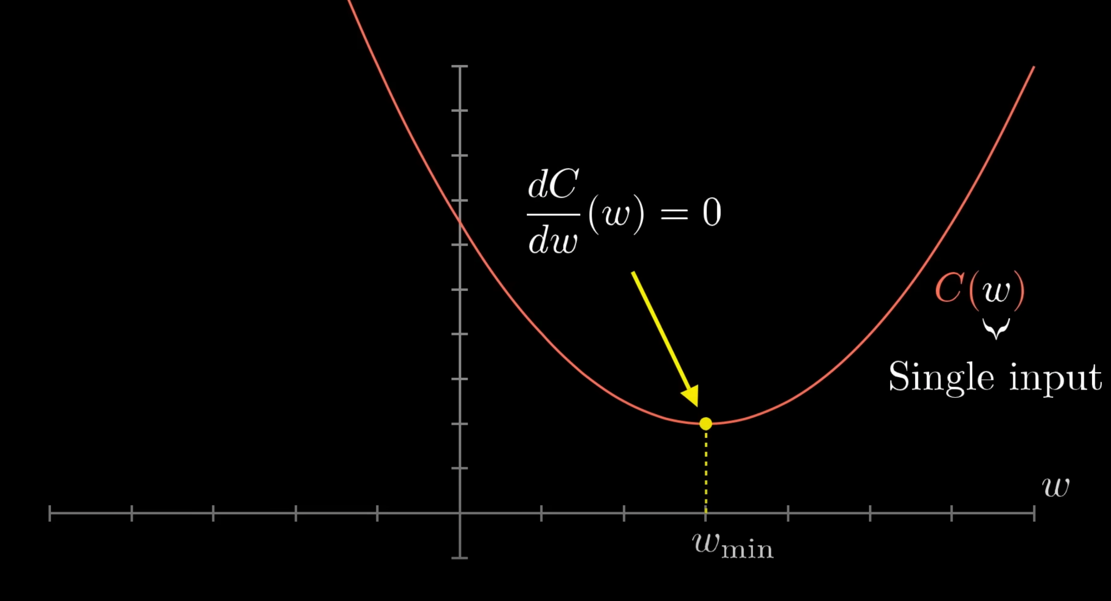
3Blue1Brown

Slide 30
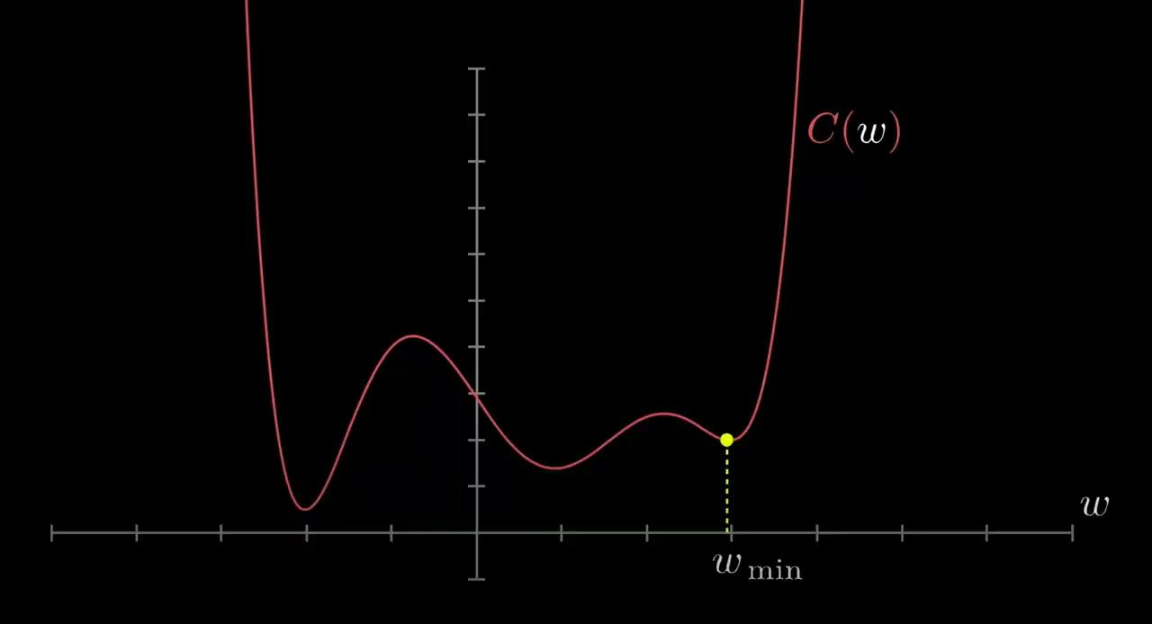
3Blue1Brown

Slide 31
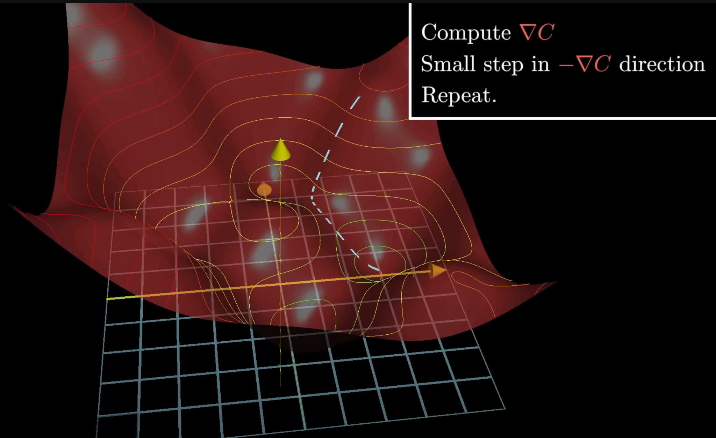
3Blue1Brown

Slide 32
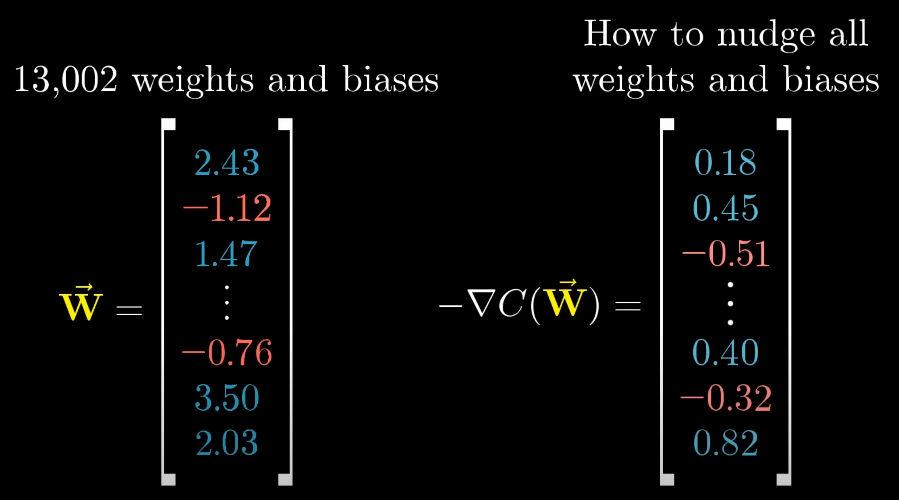
3Blue1Brown

Slide 33
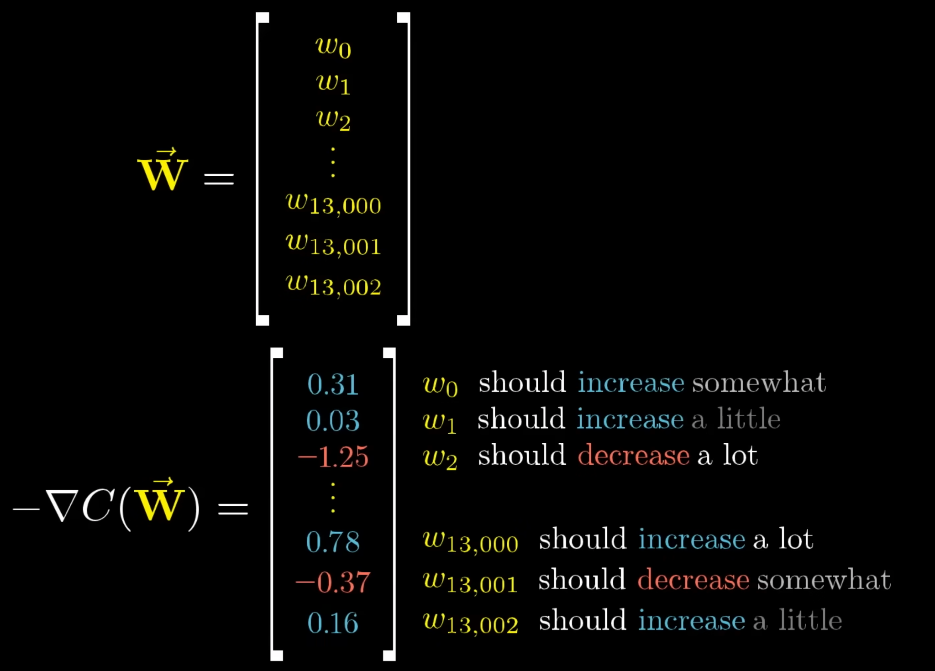
3Blue1Brown

Slide 34
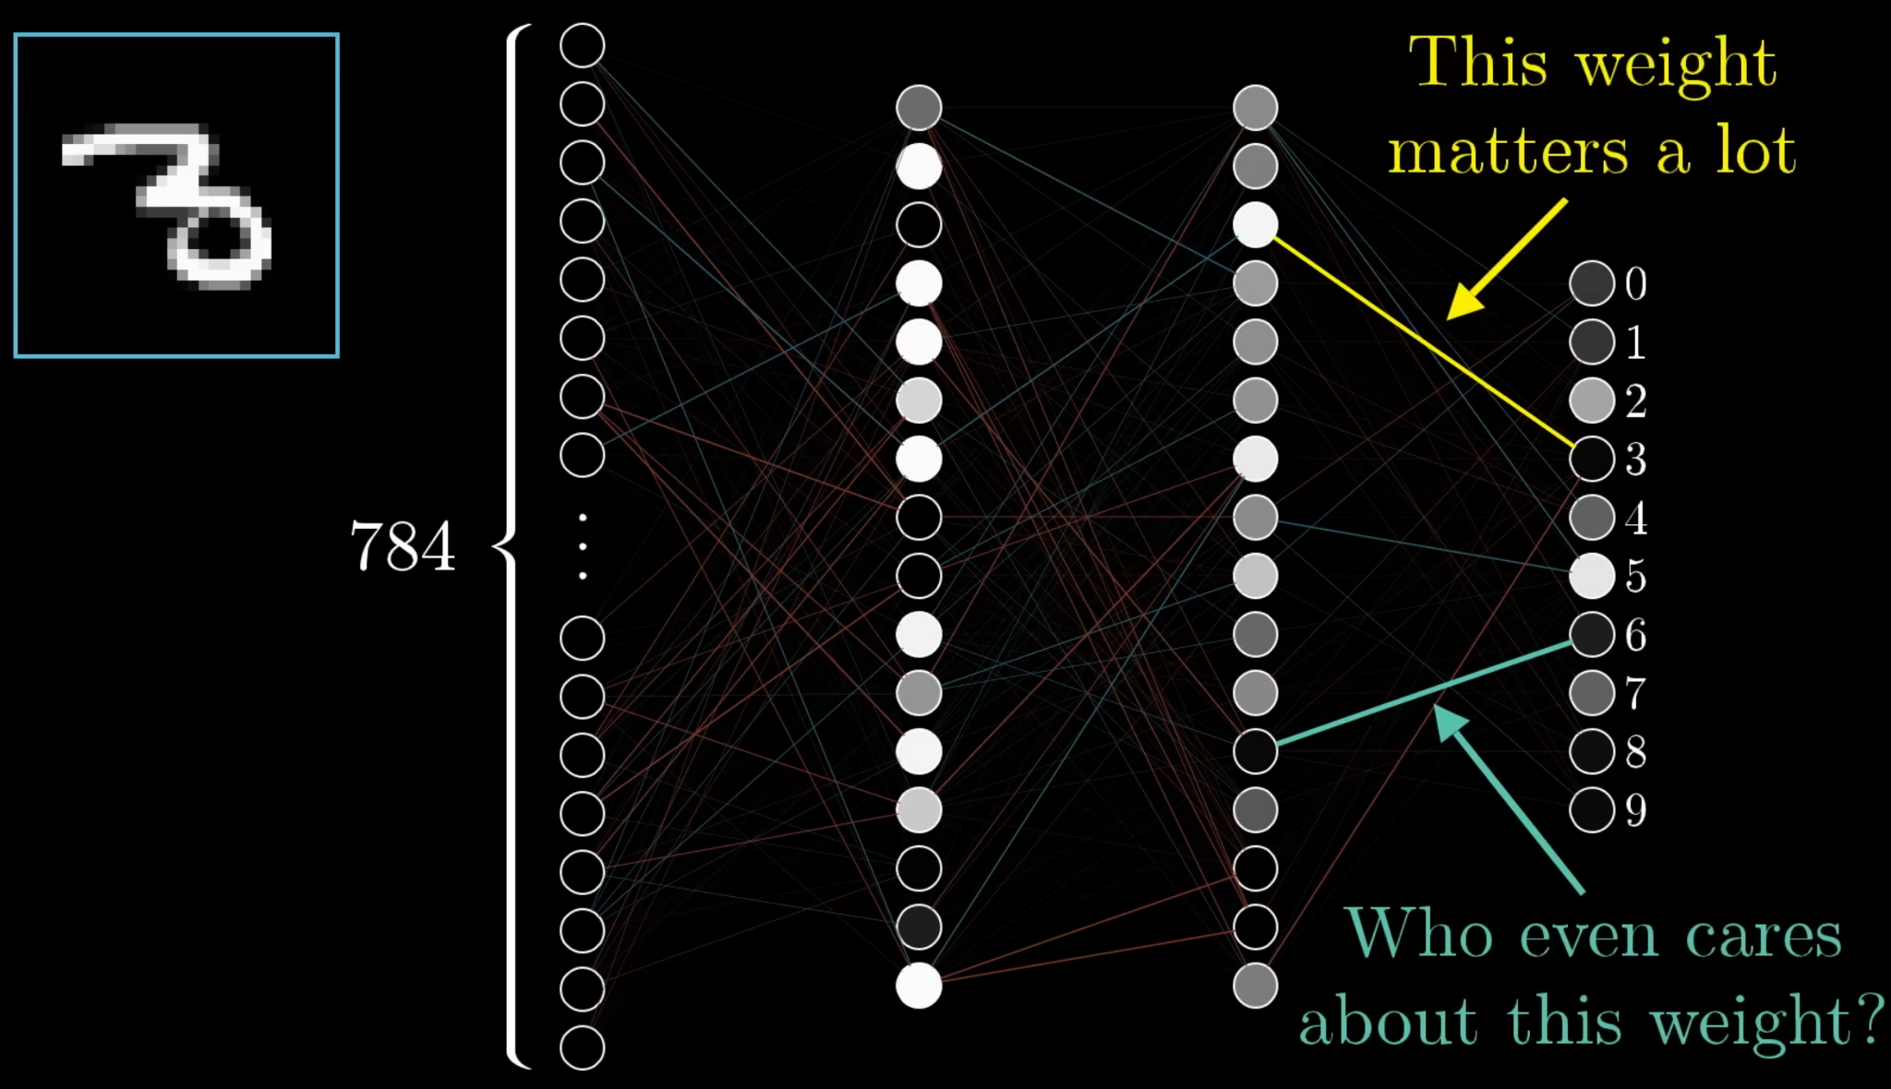
3Blue1Brown

Slide 35
Recap
Deep Learning intro
MNIST digits
Hidden layers intuition
Non-linear activation
Weights matrix
Gradient descent
Weights update
3Blue1Brown

Slide 36
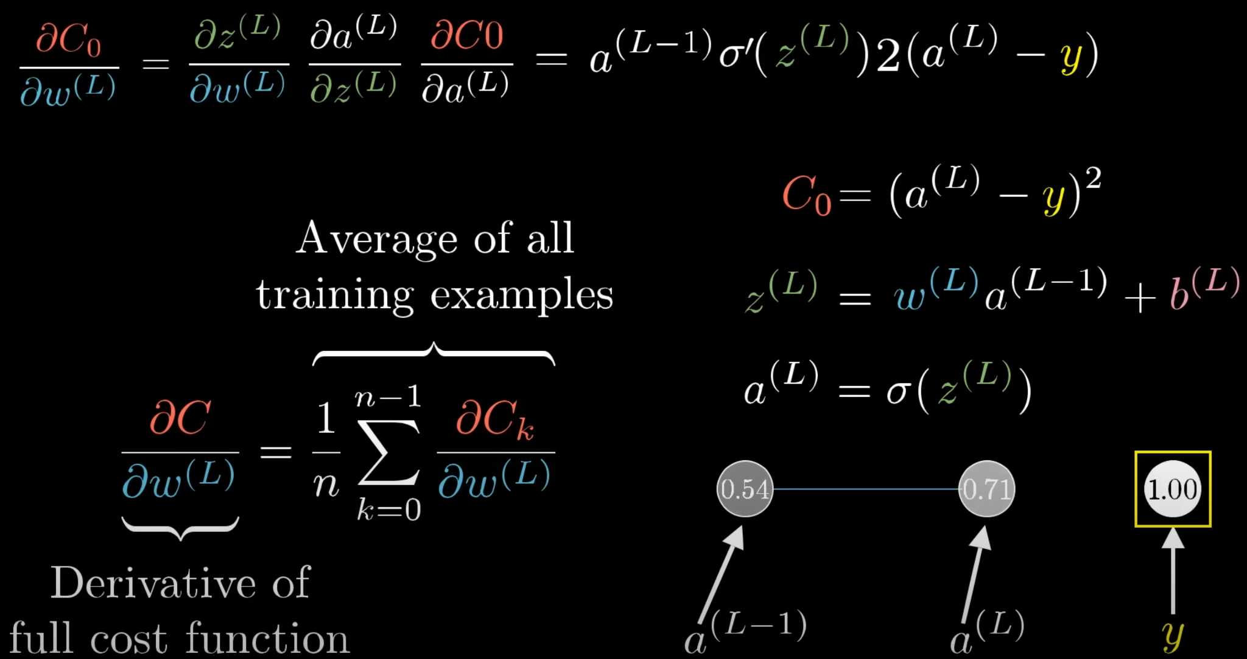
That’s all :)
Backpropagation will come soon…
3Blue1Brown

